Slide 1
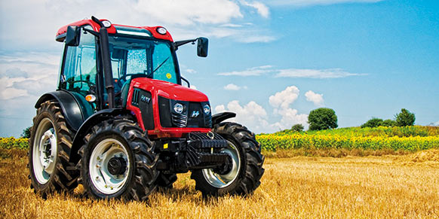
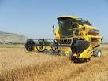
Agricultural Production Statistics Group
2- Agricultural machinary and equipment statistics

Slide 2
2- Agricultural machinary and equipment statistics :
Data are compiled yearly with the cooperation with MoFAL and controlled and analysed by TurkStat and MoFAL staff.
The data are compiled in electronic basis using Statistical Data Network (SDN) since 2007.

Slide 3
Annual data are collected for 87 kinds of agricultural equipment and machinery.
Data on agricultural equipment and machinery statistics are annual.
Data are available at the district level on the database since 1991.

Slide 4
Thank you for your attention

